Slide 1


Slide 2

Agenda: NLP
Introduction to NLP
Challenges in NLP & Key NLP Tasks
Text Preprocessing in NLP
NLP Libraries and Frameworks
Feature Extraction and Representation
Hands-on Exercise: Building a Text Classification Model
Real-world Applications
Ethical Considerations & Future of NLP

Slide 3
What is NLP
NLP (Natural Language Processing) is a branch of AI that focuses on computer-human communication using natural language.
Understanding and Generating Language: NLP enables computers to understand and generate human language.
Applications: It's used for chatbots, sentiment analysis, language translation, and more.
Challenges: NLP faces complexities like language ambiguity and cultural differences.
Techniques: It uses machine learning and linguistic rules for tasks like tokenization and sentiment analysis.
Data: Large text datasets are essential for training NLP models.
Ethical Considerations: NLP raises concerns about privacy and algorithmic bias.

Slide 4
Key Challenges in NLP
Ambiguity: Language often has multiple meanings.
Sarcasm and Humor: Understanding subtleties is tough.
Context Understanding: Interpreting context correctly is vital.
Multilingual Processing: NLP needs to work with diverse languages.
Privacy and Ethics: Data privacy and algorithmic bias are concerns.

Slide 5
Key NLP Tasks
Text Classification: Categorizing text.
Named Entity Recognition (NER): Identifying entities.
Sentiment Analysis: Assessing sentiment.
Machine Translation: Translating languages.
Language Modeling: Understanding and generating language.
Question Answering: Answering questions from text.

Slide 6
Text Preprocessing in NLP
Text Tokenization: Breaking text into individual words or tokens, making it more manageable for analysis.
Text Cleaning and Normalization: Removing unnecessary characters, such as punctuation and special symbols, and converting text to a consistent format (e.g., lowercasing) to reduce noise and variation.
Stop Words Removal: Eliminating common, low-information words (e.g., "the," "and") that don't contribute significantly to the analysis to reduce noise.
Stemming and Lemmatization: Reducing words to their base or root form. Stemming simplifies words to a common prefix, while lemmatization reduces them to their dictionary form, improving text consistency and reducing word variations.

Slide 7
NLP Libraries and Frameworks
NLTK (Natural Language Toolkit):
Functionality: Comprehensive NLP tools for various tasks.
Use Cases: Text classification, tokenization, and linguistic analysis.
spaCy:
Functionality: Fast and efficient NLP library with pre-trained models.
Use Cases: Named entity recognition, part-of-speech tagging, and text tokenization

Slide 8
NLP Libraries and Frameworks
3. Gensim:
Functionality: Specializes in topic modeling and document similarity.
Use Cases: Topic modeling, document similarity, and word embeddings.
4. Hugging Face Transformers:
Functionality: Framework for state-of-the-art NLP models.
Use Cases: Text classification, machine translation, and text generation with pre-trained models like BERT and GPT-2.

Slide 9
Feature Extraction and Representation
A) Bag of Words (BoW):
Functionality: BoW represents a document as an unordered collection of words, ignoring grammar and word order but counting word frequency.
Example:
Consider two simple sentences:
Sentence 1: "I like cats."
Sentence 2: "I love dogs and cats."
BoW representation for these sentences might look like this:
 | I | like | cats | love | dogs
Sentence 1 | 1 | 1 | 1 | 0 | 0
Sentence 2 | 1 | 0 | 1 | 1 | 1

Slide 10
Feature Extraction and Representation
B) TF-IDF (Term Frequency-Inverse Document Frequency):
Functionality: TF-IDF assigns a weight to each word based on its frequency in a document (Term Frequency) and its rarity across all documents (Inverse Document Frequency).
Example:
Using the same sentences as above:
 | I | like | cats | love | dogs
Sentence 1 | 0.693 | 0.693 | 0.693 | 0 | 0
Sentence 2 | 0.5 | 0 | 0.5 | 0.5 | 0.5

Slide 11
Feature Extraction and Representation
In the BoW matrix, each row represents a document (sentence), and each column represents a unique word in the entire dataset. The values in the matrix indicate the presence (1) or absence (0) of each word in the respective document.
In the TF-IDF matrix, the values represent the TF-IDF scores for each word in each document. These scores give more weight to words that are important in a specific document while downplaying words that are common across all documents

Slide 12
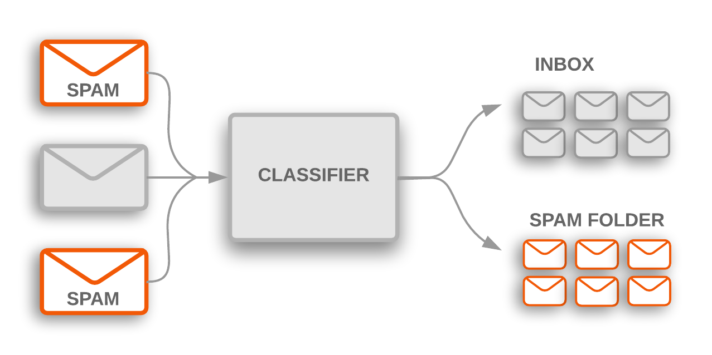
Building a Simple Text Classification Model
Creating a binary text classification model for distinguishing spam from non-spam emails:
In text classification, the goal is to categorize text documents into predefined classes or labels. A binary classification example involves sorting emails into two categories: spam and non-spam.

Slide 13
Building a Simple Text Classification Model
Steps:
Data Collection and Preprocessing:
Gather a dataset of emails that are labeled as spam or non-spam.
Preprocess the data, which includes tasks like text cleaning, lowercasing, and tokenization.
Split the data into training and testing sets to train and evaluate the model.
2) Feature Extraction:
Convert the text data into numerical features that can be used for modeling. Common techniques include Bag of Words (BoW) or TF-IDF.
Generate a feature matrix where rows represent emails, and columns represent features (e.g., word frequencies).
Example (BoW feature matrix):
 | word1 | word2 | ... | wordN
Email 1 | 2 | 0 | ... | 1
Email 2 | 0 | 3 | ... | 0
... | ... | ... | ... | ...
Email N | 1 | 0 | ... | 0

Slide 14
Building a Simple Text Classification Model
Steps:
3) Model Selection:
Choose a classification algorithm for the task. Common choices include:
Naive Bayes: Simple and effective for text classification.
Support Vector Machine (SVM): A powerful algorithm for binary classification.
Logistic Regression: Another popular choice for text classification.
Deep Learning (e.g., Neural Networks): For more complex tasks and large datasets.
4) Model Training and Evaluation:
Train the selected model using the training data.
Evaluate the model's performance using the testing data. Common evaluation metrics include accuracy, precision, recall, and F1-score.
Fine-tune the model parameters or try different algorithms to improve performance.

Slide 15
Hands-on: Text Preprocessing
For this exercise, we'll use the NLTK library to tokenize the text, perform text cleaning, and remove stop words.
Notes:
Note:- Use Jupyter file for this question - Text Preprocessing - NLP.ipynb

Slide 16
Hands-on: Text Classification
Building a simple NLP (Natural Language Processing) model for text classification using.
This model will classify text messages (email) as either "ham" (not spam) or "spam."
Notes:
Note:- Use Jupyter file for this question - Text Classification - Email (Spam-Ham).ipynb

Slide 17
Hands-on: Sentiment Analysis
Dataset: IMDB Movie Review
Notes:
Note:- Use Jupyter file for this question - Sentiment Analysis (NLP) - IMBD Movie Review.ipynb

Slide 18
Questions ?

Slide 19
Thank You !

